Slide 1

PRACTICAL
OBJECT-ORIENTED
DESIGN WITH UML
2e
Chapter 12:
Constraints

Slide 2
Constraints
Most of UML’s notation is graphical
  this is good for expressing structural properties
Most systems have properties or business rules that cannot be shown on diagrams
  eg that the balance in a bank account must be within the range 0 to 250,000
Such properties can be added to a model in the form of constraints

Slide 3
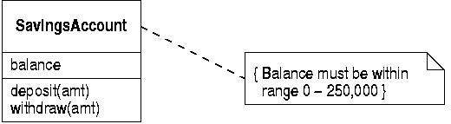
A Simple Constraint
Constraints are Boolean assertions
  they are attached to one or more model element
  this shows a note containing a class constraint

Slide 4
UML Constraints
Constraints can be expressed using informal English
UML defines a some standard constraints to handle common situations
  the xor constraint
  the subset constraint
The formal language OCL can be used to write precise, general constraints

Slide 5
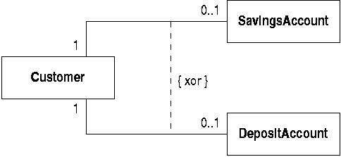
The xor Constraint
The xor constraint asserts that two associations are mutually exclusive
  a customer can hold a savings account or a deposit account, but not both

Slide 6
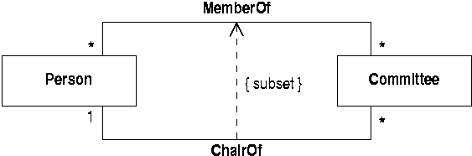
The subset Constraint
The subset constraint asserts that objects linked by one association are also linked by another
  the chair of a committee is also a member of it

Slide 7
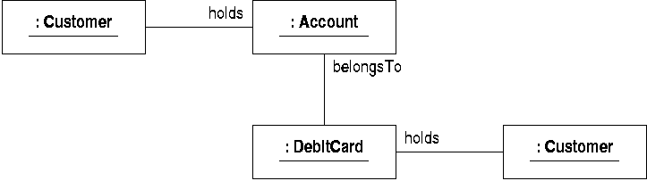
The Need for General Constraints
Many constraints cannot be handled by these general means
  eg we might want to rule out this situation

Slide 8
Formulating a Constraint
We could express the constraint as follows
  find the holder of any given debit card
  find the holder of the account it belongs to
  you must reach the same customer each time
OCL: the Object Constraint Language
  a user-friendly formal language
  expresses constraints precisely and concisely
  well-adapted for use with UML

Slide 9
Requirements for OCL
A constraint language should provide
  the ability to specify what model elements are being constrained
  the ability to navigate through the model to identify related objects and data values
  the ability to make assertions about the entities reached through navigation

Slide 10
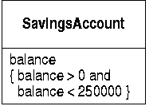
The Context of a Constraint
Every OCL constraint has a context
  this relates the constraint to the model elements being constrained
Constraints can be shown on diagrams
  in the constrained element or in an attached note

Slide 11
Textual Constraints
Constraints are more often written as text accompanying a model
  they start with a context declaration defining the context
    context SavingsAccount inv:
      self.balance > 0
      and self.balance < 250000
  ‘inv’ indicates that the constraint is an invariant

Slide 12
Constraint Syntax
A dot ‘.’ is used to refer to a feature of a model element, such as an attribute value
‘self’ refers to the context object
  it can be omitted if preferred
the context object and the constraint itself can be named
    context acc:SavingsAccount inv limits:
    acc.balance > 0
    and acc.balance < 250000

Slide 13
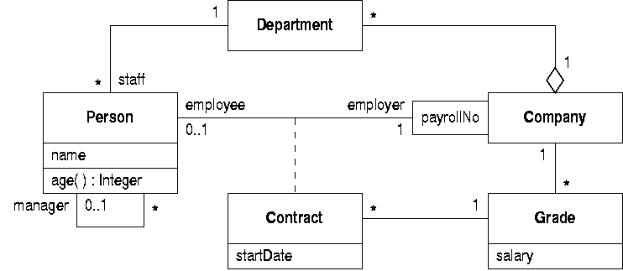
An Payroll System
Further examples are based on this model

Slide 14
Navigation Expressions
Starting from the context object we can follow links to arrive at other objects
To navigate across an association use
  the role name at the far end of the association
  or the name of the class at the far end
The dot notation is used to separate these from the context object name

Slide 15
Simple Navigations
“The employees working in a department”
  this uses a role name
    context Department inv:
    self.staff
“The set of all departments in the company”
  this uses a class name
    context Company inv:
    self.department

Slide 16
Objects and Collections
What does a navigation expression return?
  if there are many linked objects a collection is returned
  if there is one linked object, the object is returned
  if there are no linked objects, an empty collection is returned
OCL converts single objects to collections wherever necessary
  it is as if a collection was always returned

Slide 17
Iterated traversal
More complex navigation expressions can follow a chain of associations
  “All the people who work for the company”
    context Company inv:
    self.department.staff
This is evaluated in a step-by-step manner
  first get the collection of departments
  then get the staff in each department
  merge these collections of staff to get the result

Slide 18
Qualified Associations (1)
Navigation towards the qualifier is the same as unqualified associations
In the other direction, use qualifier values to identify individuals:
  “the employee with payroll number 314159”
    context Company inv:
    self.employee[314159]

Slide 19
Qualified Associations (2)
Qualifiers can be combined with further navigation:
  “that person’s manager”
    context Company inv:
    self.employee[314159].manager
Or omitted altogether:
  “all the company’s employees”
    context Company inv:
    self.employee

Slide 20
Association Classes
Navigate from in the normal way:
  “all the employees of a particular grade”
    context Grade inv:
    self.contract.employee
Navigate to using association class name:
  “the grade of a particular employee”
    context Person inv:
    self.contract.grade

Slide 21
OCL Basic Types
OCL defines basic types to describe data
  Boolean
  Integer
  Real
These can be assumed to be the same as the corresponding UML types

Slide 22
Model Types
UML classes give rise to OCL model types
Model types have a number of properties
  every UML attribute gives rise to a property
  the far end of an association attached to the class gives rise to a property
  query operations give rise to properties
Not every operation is a property
  OCL expressions must not change object state

Slide 23
Property Values
Properties are denoted with the dot notation:
  “the age and salary of an employee”
    context Person
    inv: self.age()
    inv: self.contract.grade.salary
Property expressions can denote collections
  “the names of employees in a department”
    context Department inv:
    self.staff.name

Slide 24
Enumerations
UML enumerations can be used in constraints
  “a signal must be red or green”
    context Signal inv:
    colour = Colour::red
    or colour = Colour::green

Slide 25
Collections
What is the salary bill for a department?
  collect the grades of each staff member
    context Department inv:
    self.staff.contract.grade
  and add up the salaries
But there will be many staff members on the same grade
  a set of grades will give the wrong answer

Slide 26
Collection Types
OCL defines three types of collection:
  sets: an object can only appear once in a set
  bags: an object can appear more than once
  sequences: objects in a sequence are ordered
Navigation from a single object returns a set
  because there can only be one link to an object
Navigation from a set returns a bag
  so we get a bag of grades in the example

Slide 27
Operations on Collections
We can add up the elements in a collection:
  “the total salary bill for a department”
    context Department inv:
    staff.contract.grade->sum()
  collection operations are preceded by ‘->’
Or find the number of different grades
  convert the bag to a set and get its size
    context Department inv:
    staff.contract.grade->asSet()->size()

Slide 28
Selecting elements
Sometimes we are only interested in some elements in a collection
  “employees with a salary greater than 50,000”
    context Company inv:
    self.employee->select(p:Person |
    p.contract.grade.salary > 50000)

Slide 29
The Select Operation
The ‘local variable’ is optional but can clarify expressions
‘select’ returns a collection that can be used for further navigation
  “the managers of highly paid employees”
    context Company inv:
    employee->select
    (contract.grade.salary > 50000).manager

Slide 30
The Collect Operation
We can collect together the values of an expression applied to every element of a collection
  “the ages of all employees in a department”
    context Department inv:
    staff->collect(p:Person | p.age())
  “the company’s salary bill after a 10% pay rise”
    context company inv:
    contract.grade
    ->collect(salary*1.1)->sum()

Slide 31
Shorthand for Collect
Often we want to collect all the values of a particular attribute over a collection
    context Department inv:
    self.staff->collect(name)
This is usually abbreviated to the familiar
    context Department inv:
    self.staff.name

Slide 32
Basic Constraints
Write navigation expressions to denote the data values of interest
Use relational operations to express the constraint
  “an employee works for the company that their department is in”
    context Person inv:
    self.employer = self.department.company

Slide 33
Constraints on Collections
Various properties of collections can be tested
  two ways of saying that all employees are aged 18 or more
    context Department inv:
    employee->select(age()<18)->isEmpty()
    context Department inv:
    employee->select(age()<18)->size() = 0

Slide 34
Collection predicates
We can check that an object is in a collection
  “every grade used is known to the company”
    context Person inv:
    employee.grade->includes(contract.grade)
And that one collection is included in another
  “a department’s staff all belong to the company”
    context Department inv:
    company.employee->includesAll(staff)

Slide 35
Combining Constraints
Combine constraints using Boolean operators
  not, and, or, xor
OCL also has an ‘implies’ operator
  “every employee over 50 gets at least 25000”
    context Person inv:
    age() >= 50 implies
    contract.grade.salary >= 25000

Slide 36
Iterative Constraints
Iterative constraints apply a Boolean expression to every member of a collection
The ‘forAll’ quantifier checks if a property is true for all members of a collection
  “there is an employee at every grade”
    context Company inv:
    self.grade->forAll( g : Grade |
    not g.contract->isEmpty())

Slide 37
The ‘exists’ Quantifier
The ‘exists’ quantifier checks if a property is true for at least one member of a collection
  “every department has a head” (defined as someone with no manager)
    context Department inv:
    staff->exists(e : Person |
    e.manager->isEmpty())

Slide 38
All Class Instances
Simple constraints apply to all instances
  “the salary for every grade is more than 20000”
    context Grade inv:
    salary > 20000
The ‘allInstances’ operation does this explicitly
    context Company inv:
    Grade.allInstances->forAll(g |
    g.salary > 20000)

Slide 39
Comparing Class Instances
This is necessary to state some properties of the instances of a class
  “no two grades have the same salary”
    context Grade inv:
    Grade.allInstances->forall(g : Grade |
    g <> self implies
    g.salary <> self.salary
  both ‘self’ and ‘g’ range over all grades

Slide 40
Class Invariants
Most constraints state properties of classes that are meant to be true at all times
These are known as invariants
  “an account’s balance must be in a given range”
    context SavingsAccount inv:
    balance > 0 and balance < 25000

Slide 41
Preconditions
Sometimes constraints are used to define properties of operations
Preconditions state what must be true before an operation is executed
  “you can only withdraw an amount less than the balance in an account”
  context SavingsAccount::withdraw(amt:Real)
    pre: amt < balance

Slide 42
Postconditions
Postconditions specify the result of an operation
  “withdraw withdraws the amount given to it”
  context SavingsAccount::withdraw(amt:Real)
    post: balance = balance@pre amt
  ‘balance@pre’ denotes the balance before the operation executed

Slide 43
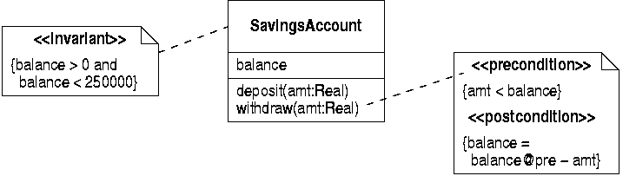
Stereotyped Constraints
Constraints can be stereotyped if they are shown on a class diagram

Slide 44
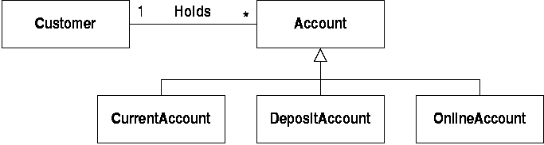
Constraints and Generalization
Generalization doesn’t give rise to any navigable relationships
Sometimes the run-time type of an object is important for a constraint

Slide 45
Checking Run-time Type
“Every customer holds a current account”
context Customer inv:
account->size() > 0 implies
account.select(oclIsTypeOf(CurrentAccount))
->size() > 1
  “if the customer holds any accounts at all, at least one of them must be a current account”
  ‘oclIsTypeOf’ returns true if an object belongs to the specified type

Slide 46
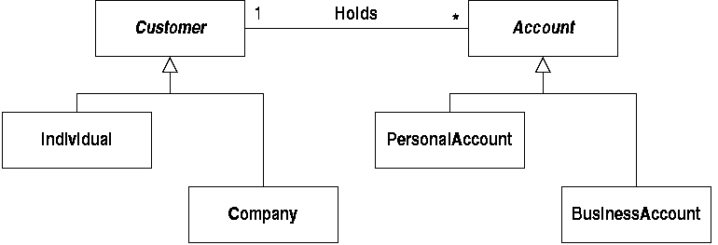
Parallel Generalization
Another situation with parallel hierarchies
  “only individuals can hold personal accounts”

Slide 47
Finding the Type of an Object
Check that all the accounts belonging to an individual are of the correct class
  context Individual inv:
  account->forAll(a : Account |
  a.oclType = PersonalAccount)
  ‘oclType’ returns the type of any object

